Slide 1

The Influence of Lexical Aspect, Task Variability and Proficiency Level on Chinese Learners’ Acquisition of the English Progressive Aspect
Xiaoyan Zeng
Xiaoxiang Chen

Slide 2
1
Introduction
2
Literature Review
Outline
3
Methodology
4
Results
5
Discussion
6
Conclusion

Slide 3
1. Introduction
Research Background
The correct use of English progressive aspect has been mentioned as one of
the hardest part to be acquired in SLA, even for the most advanced
learners (Swan and Smith, 2001).
Research on the progressive aspect has been less enthusiastically
addressed in L2 acquisition and it is generally regarded the by-product
of investigation of past tense acquisition. (Bardovi-Harlig, 2005, 2012).

Slide 4
1. Introduction
Research Background
(Vendler, 1957)
Aspect System
Lexical aspect
Activities
(ACT)
Accomplishments
(ACC)
Grammatical aspect
Achievements
(ACH)
States
(STA)
walk
run
paint a picture
build a house
drop
fall
love
know

Slide 5
1. Introduction
Research Background
English Progressive aspect (Shirai and Kurono, 1998)
(1) Activity: Action in progress
He’s running. She’s playing the guitar.
(2) Accomplishment: Iterative action in progress
He’s jumping. He’s knocking on the door.
(3) Achievement: Process leading up to the endpoint
He’s reaching the summit. He’s leaving.
(4) State: Vividness; temporariness
I’m liking it! I’m thinking that he might be sick.
*I am owning a car. *I am knowing him.

Slide 6
1. Introduction
Research Questions
1. What are the emerging patterns of the English progressive marking with lexical
aspect in both oral and written tasks for L1 Chinese learners?
2. Are different proficiency levels of Chinese learners influenced by lexical aspect in
their using progressive aspect?
3. Are progressive markings overextended to stative verbs by Chinese learners and
English speakers in both tasks?

Slide 7
1. Introduction
Significance of the study
The study will provide much-needed empirical evidence for the controversial evidence of the stative progressive reported in second language learning from a non-Indo European language. (Chinese learners’ acquisition of tense-aspect morphology)
It will investigate and discuss multiple factors (lexical aspect, and subject's language proficiency level and task variation) when testing the form-meaning association in L2 tense-aspect acquisition.

Slide 8
2. Literature Review
2.1 The Aspect Hypothesis (Andersen & Shirai, 1996)
(On progressive acquisition)
In languages that have progressive aspect, progressive marking begins with activity verbs, and then extends to accomplishment or achievement verbs.
b) Progressive aspect marking is not incorrectly overextended to state
verbs.

Slide 9
2. Literature Review
2.2 The Prototype Hypothesis (Andersen & Shirai, 1996)
This hypothesis proposed that language learners initially acquire the prototypes for each aspectual morpheme and then gradually extend their scope to less prototypical cases.

Slide 10
2. Literature Review
2.3 Research Gaps
Few studies focused on the acquisition of stative progressives.
Few researches on Aspect Hypothesis took isolated language learners, for example Chinese.

Slide 11
3. Methodology
3.1 A Corpus Study
A spoken corpus and a written corpus
Sub-corpora | tokens | Words
TEM8 | 883 | 223,450
ST6 | 571 | 176,110

Slide 12
3. Methodology
The 3-factor mixed design:
Lexical aspect: statives, activities, accomplishments and
achievements (Vendler,1967; Shirai, 1991 )
Proficiency level : intermediate and advanced
Task variation: Spoken and written

Slide 13
4. Results
Result 1
Figure 1 Percentage Distribution of the progressive aspect across the lexical aspect in the corpora

Slide 14
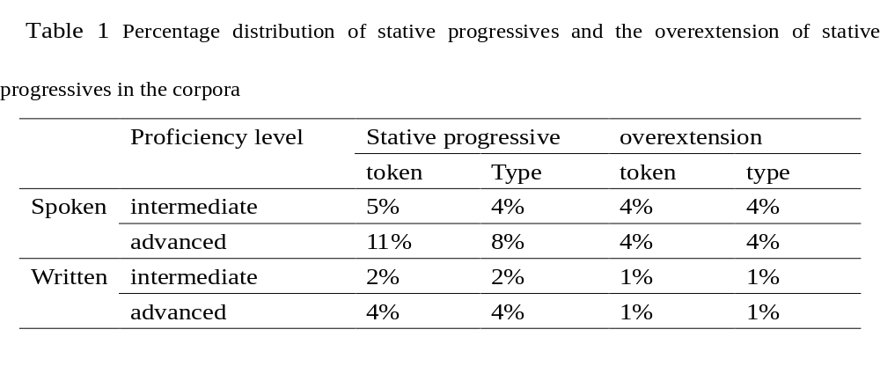
4. Results
Result 2

Slide 15
5. Discussion
Discussion 1
Through analyzing the corpora, it is clear that the strength of combination between progressive aspect marker and four types of lexical aspects has a significant hierarchy: ACT > ACC > ACH > STA, which is in support of the Aspect Hypothesis.
As for the distribution differences between the two groups, Chinese learners could be influenced by L1. In Chinese, progressive marker "zai" is not obligatory, that is, there are many grammatical ways to achieve progressive in Chinese (Smith, 1997). Whereas, the English progressive marker is obligatory.

Slide 16
5. Discussion
Discussion 1
As for the difference between spoken and written tasks, there is a close involvement between speakers and the situation in spoken language; thus, speakers tend to give a talk upon the immediate situation.(Chafe & Tannen, 1987)
However, written langage is independent of the immediate situation; therefore, there is a detachment between speakers and the situation.(Chafe & Tannen, 1987)

Slide 17
5. Discussion
Discussion 2
The following hierarchy is valid in both two proficiency level learners: ACT > ACH > STA, which is support of the Prototype Hypothesis.
Due to the semantic sense, the stative verb is non-prototype in progressive aspect; thus, it is usually the last and the most difficult one to be acquired.
Besides, Chinese progressive aspect can be combined with a small number of state verbs (conveying stage meaning). (Xiao & McEnery, 2004)

Slide 18
6. Conclusion
6.1 Major Findings
L1 Chinese learners follow the general predictions of the Aspect Hypothesis about the English progressive marking with lexical aspect.
Learners’ proficiency level has an effect on the distribution of progressive aspect.
Overextension of progressive inflections to stative verbs are observed in Chinese learners , both in spoken and written tasks.

Slide 19
6. Conclusion
6.2 Limitations
Only L1 background learners, L1 transfer effect is hard to detect;
It is better to compare learners’ data with native speakers’ data;

Slide 20
6. Conclusion
6.3 Prospects for Future Research
A wider range of proficiency levels is recommended;
Whether the tense-aspect acqusition is influenced by the L1 is expected;
The non-prototypical meanings of progressive aspect smarking could be examined in more detail.

Slide 21
Main References
[1] Andersen, R. W., & Shirai, Y. (1994). Discourse motivations for some cognitive acquisition principles. Studies in Second Language Acquisition, 16, 133-156.
[2] Bardovi-Harlig, K. (2012). After process, then what? A longitudinal investigation of the progressive prototype in L2 English. Tense, aspect and mood in first and second language acquisition, 24, 131-151.
[3] Bardovi-Harlig, K. (2013). Research design: From text to task. Research Design and Methodology in Studies on L2 Tense and Aspect. Berlin: Walter de Gruyter, 219-269.
[4] Li, P., & Shirai, Y. (2000). The acquisition of lexical and grammatical aspect (Vol. 16). Walter de Gruyter.
[5] Römer, U. (2005). Progressives, patterns, pedagogy: A corpus-driven approach to English progressive forms, functions, contexts and didactics (Vol. 18). John Benjamins Publishing.
[6] Rooy, B. (2014). Progressive aspect and stative verbs in Outer Circle varieties. World Englishes, 33(2), 157-172.
[7] Shirai, Y. (2013). Defining and coding data: Lexical aspect in L2 studies. Research Design and Methodology in Studies on L2 Tense and Aspect. Berlin: Walter de Gruyter, 271-308.
[8] Shirai, Y. (2016). 2 The acquisition of linguistic categories in second language acquisition: A functionalist approach. Cognitive-Functional Approaches to the Study of Japanese as a Second Language, 46, 13.
[9] Swan, M. & Smith, B. (2001). Learner English: A teacher's guide to interference and other problems. Ernst Klett Sprachen.
[10]Tracy-Ventura, N., & Myles, F. (2015). The importance of task variability in the design of learner corpora for SLA research. International Journal of Learner Corpus Research, 1(1), 58-95.

Slide 22
Thanks for your attention !

