Slide 1

Using Generalizability Theory to Examine the Air Reserve Component Augmentation (ARC) Request Process
The 4th Untested Ideas (UI) International Research Conference
Gina M. Pizziconi-Cupples
Niagara University

Slide 2
Overview
Rationale & Purpose for Study
Conceptual Framework & Literature Review
  Historical Context
  Politics
  Policies
  Economics
  Ethics
Methodology
  Appropriates of G-Theory for this Study
  Research Questions
  Data Connection
  G-Theory Design
Results
  Findings
  Discussion
Conclusion
  Implications
  Limitations
  Future Research

Slide 3
Rationale & Purpose of Study
Unprecedented reliance on reserve components
  Utilization has transitioned to an operational norm
Desire and efforts to increase reserve component utilization are hampered by outdated policies and processes
Less than 1% of US population has served in military compared to 12% in World War II
  Widens gap in understanding between military and public including congress
Study will contribute to recommendations made by the National Commission on the Structure of the Air Force (NCSAF)
Purpose is to investigate variability and reliability within the air reserve component augmentation process

Slide 4
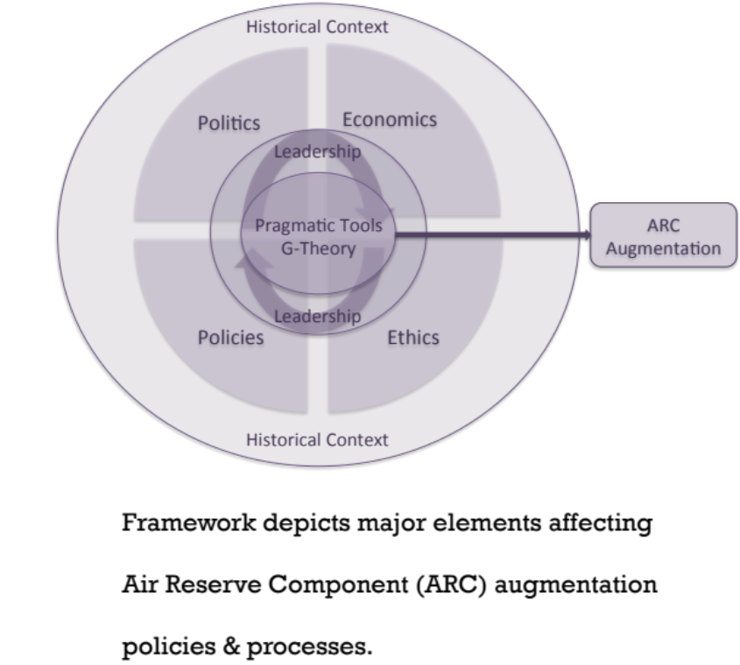
Conceptual Framework & Literature Review
Historical Context
  Intersection of decreasing end strength, fiscal constraints
  & increasing military requirements
Politics
  Congressional Level
  Internal to the Air Force
Policies
  Federal Legislation
  Department of Defense Instructions
    Accessing the Reserve Component
  Air Force Instructions
    Current ARC Augmentation Request
    Process

Slide 5
Conceptual Framework & Literature Review
Economics
  Significant Fiscal Constraints
    Budget Control Act (2011)
    & Sequestration
Ethics
  Stewardship in Government
  Social Contract with Reserve Members

Slide 6
Methodology
Appropriateness of G-Theory for this Study
  Untangles sources of error & approximates error for each variance component
  G-Studies express variation & D-Studies uses G-Study information to determine reliability levels of specifications selected by the researcher
Research Questions
  To what extent do variance components contribute to rating variability?
  What is the rating reliability (G-coefficient) of requests?
  To what extent does gender and assignment affect rating variability and
  rating reliability (G-coefficient) of requests?
Data Connection
  Decision-making framework for ARC augmentation request process
  Description of Data
  Information Protection Controls
G-Theory Design
  Both fully crossed and nested designs were utilized
    Most complex design is three-facet, nested design

Slide 7
Methodology
27-Designs
  18 Fully crossed designs & 9 nested designs
    Object of measurements were: (1) the priority of a requests (q)
    & (2) the rater (r)
  Facets were determined to be random; gender was treated as fixed
Dataset:
    251 effective requests (q), 9 core functions (f), 5 mission categories (c), 3 mission areas (o)
Participants (raters (r)):
  5 male, 2 female; 4 assigned to headquarters, 3 assigned to a field unit
Analysis
  Preparation, random selection (balanced design requirement)
  Descriptive statistics
  G-Studies
  D-Studies
  Computer Programs

Slide 8
Results
Findings to Research Questions
  To what extent do variance components contribute to rating variability?
    Notwithstanding residual interactions, mission category (c) contributed the greatest variance most often. Possible reasons include:
      Possibly misalignment of mission categories?
      Errors in mission category identification?
      Raters view categories differently?
  What is the rating reliability (G-coefficient) of requests?
    Overall reliability was low based on 7 raters
      Highest levels were seen in (r: a) x q at .58; r x q_{c1} at .56; r x q_{f3} at .54
  To what extent does gender and assignment affect rating variability and
  rating reliability (G-coefficient) of requests?
    Gender and assignment appear to greatly affect variability and reliability
      Highest levels of reliability observed with (r: a) x q at .58
      Lowest levels of reliability observed with r_{female} x q at .04
        Female raters were at different headquarters levels

Slide 9
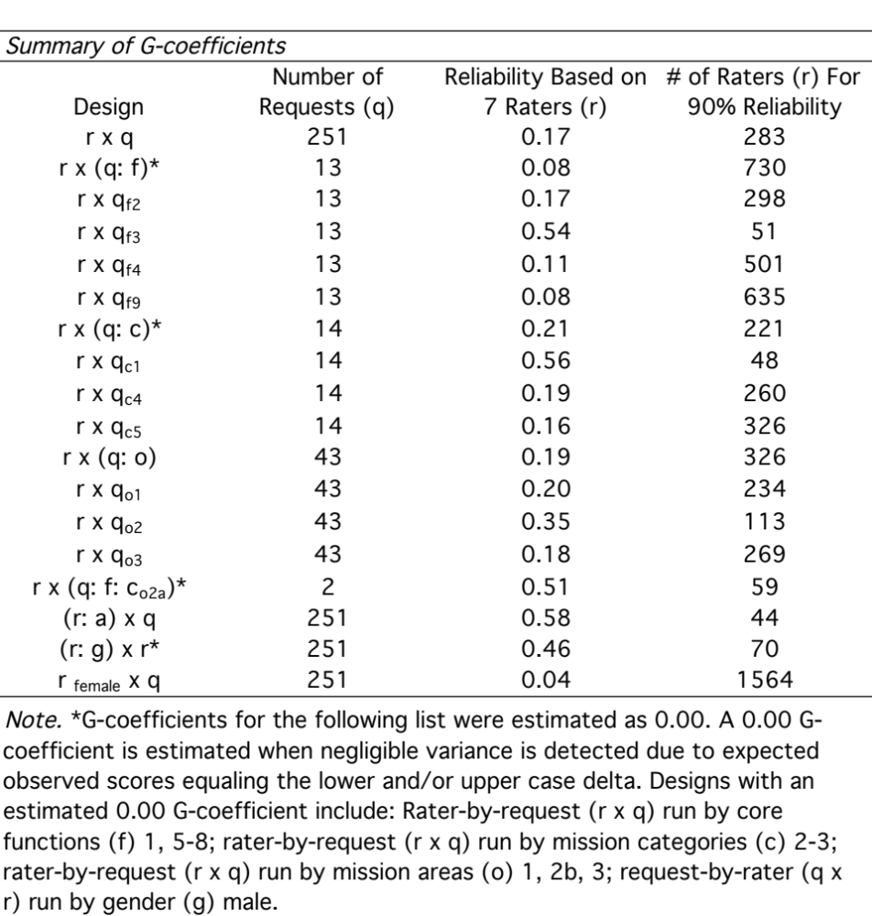
Results/Discussion

Slide 10
Conclusion
Implications
  Policy
    Scoring fatigue may affect variability and reliability
      Automate reoccurring requests & reserve panel reviews for new/emergent requests
    Standard request format may decrease variance & ensure variability is consistent with the actual priority of the request (wanted variance)
    Review mission categories for accuracy & consistency
      Mission category was contributed to the most variance as a single facet
  Leadership
    Military officials periodically re-emphasize the criticality of ARC utilization as well as re-introduce the purpose of the ARC Requirements Cell
    Full review & synthesis of internal/external policies to comprehensively understand obstructions to ARC utilization

Slide 11
Conclusion
Limitations
  Existing data sample size
    Prevented a four-facet, nested design r x (q: f: c: o) due to G-Theory balancing requirements
    Number & assignment of raters
      More raters from both genders as well as more raters from Headquarters Air Force would enhance understanding of the rater as the object of measurement
    Limited peer-reviewed publications related to ARC utilization
Future Research
  Repeat this study in FY2017 with the full sample of scored requests
  Qualitative and/or mixed methods investigating:
    Policies obstructing ARC utilization
    Leadership perspectives on ARC utilization
    Field perspectives on ARC augmentation requests

Slide 12
References
Belasco, A. (2015). Defense spending and the budget control act limits (Report No. R44039). Retrieved from the Federation of American Scientists website https://www.fas.org/sgp/crs/natsec/R44039.pdf
Bob Stump National Defense Authorization Act for Fiscal Year 2003, Pub. L. No. 107-314 § 401-414, 116 Stat. 2524-2528 (2002)
Carl Levin and Howard P. “Buck McKeon National Defense Authorization Act for Fiscal Year 2015, Pub. L. No. 113-291 § 401-415, 128 Stat. 3348-3350 (2014).
Duncan Hunter National Defense Authorization Act for Fiscal Year 2009, Pub. L. No. 110-417 § 401-416, 122 Stat. 4428-4430 (2008).
Floyd D. Spence National Defense Authorization Act for Fiscal Year 2001, Pub. L. No. 106-398 § 401-415, 114 Stat. 1654A-92-95 (2000).
John Warner National Defense Authorization Act for Fiscal Year 2007, Pub. L. No. 109-364 § 401-415, 120 Stat. 2168-2172 (2006).
National Commission on the Structure of the Air Force. (2014). Report to the President and Congress of the Unites States. Retrieved from http://afcommission.whs.mil
National Defense Authorization Act for Fiscal Year 1996, Pub. L. No. 104-106 § 401-416, 110 Stat. 285-289 (1996).

Slide 13
References
National Defense Authorization Act for Fiscal Year 1997, Pub. L. No. 104-201 § 401-414, 110 Stat. 2503-2509 (1996).
National Defense Authorization Act for Fiscal Year 1998, Pub. L. No. 105-85 § 401-413, 111 Stat. 1719-1721 (1997).
National Defense Authorization Act for Fiscal Year 2000, Pub. L. No. 106-65 § 401-415, 113 Stat. 585-587 (1999).
National Defense Authorization Act for Fiscal Year 2002, Pub. L. No. 107-107 § 401-415, 115 Stat. 1069-1076 (2001).
National Defense Authorization Act for Fiscal Year 2004, Pub. L. No. 108-136 § 401-415, 117 Stat. 1450-1453 (2003).
National Defense Authorization Act for Fiscal Year 2006, Pub. L. No. 109-163 § 401-415, 119 Stat. 3218-3222 (2006).
National Defense Authorization Act for Fiscal Year 2008, Pub. L. No. 110-181 § 401-416, 122 Stat. 86-92 (2006).
National Defense Authorization Act for Fiscal Year 2010, Pub. L. No. 111-84 § 401-415, 123 Stat. 2265-2267 (2009).

Slide 14
References
National Defense Authorization Act for Fiscal Year 2012, Pub. L. No. 112-81 § 401-415, 125 Stat. 1382-1384 (2011).
National Defense Authorization Act for Fiscal Year 2013, Pub. L. No. 112-239 § 401-415, 126 Stat. 1707-1711 (2013).
National Defense Authorization Act for Fiscal Year 2014, Pub. L. No. 113-66 § 401-415, 127 Stat. 744-746 (2013).
National Defense Authorization Act for Fiscal Year 2014, Pub. L. No. 113-66 § 401-415, 127 Stat. 744-746 (2013).
National Defense Authorization Act for Fiscal Year 2016, H.R. 1735 § 401-415, 77-78 (2013).
Ronald W. Reagan National Defense Authorization Act for Fiscal Year 2005, Pub. L. No. 108-375 § 401-416, 118 Stat. 1862-1866 (2004).
Strom Thurmond National Defense Authorization Act for Fiscal Year 1999, Pub. L. No. 105-261 § 401-414, 112 Stat. 1995-1998 (1998).
Torreon, B.S. (2015). U.S. periods of war and dates of recent conflicts (Report No. RS21405). Retrieved from Congressional Research Service website www.crs.gov

